Slide 1
Syntax Analysis

Slide 2
Bottom-Up Parsing
A bottom-up parser creates the parse tree of the given input starting from leaves towards the root
A bottom-up parser tries to find the right-most derivation of the given input in the reverse order.
S ⇒ ... ⇒ ω (the right-most derivation of ω)
← (the bottom-up parser finds the right-most derivation in the reverse order)

Slide 3
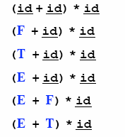
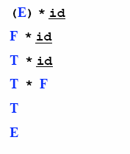
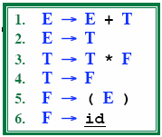
Reduction
A reduction step replaces a specific substring (matching the body of a production)
Reduction is the opposite of derivation
Bottom up parsing is a process of reducing a string ω
to the start symbol S of the grammar

Slide 4
Handle
Informally, a handle is a substring (in the parsing string) that matches the right side of a production rule.
– But not every substring matches the right side of a production rule is handle
A handle of a right sentential form γ (≡ αβω) is a production rule A → β and a position of γ
where the string β may be found and replaced by A to produce the previous right-sentential form in a rightmost derivation γ .
S ⇒ αAω ⇒ αβω

Slide 5
Handle Pruning
A right-most derivation in reverse can be obtained by
handle-pruning.
n-th right-sentential form
rm rm rm rm rm
S=γ₀ ⇒ γ₁ ⇒ γ₂ ⇒ ... ⇒ γ_{n-1} ⇒ γ_{n}= ω
input string
Start from γ_{n}, find a handle A_{n}→β_{n} in γ_{n}, and replace β_{n} in by A_{n} to get γ_{n-1}.
Then find a handle A_{n-1}→β_{n-1} in γ_{n-1}, and replace β_{n-1} in by A_{n-1} to get γ_{n-2}.
Repeat this, until we reach S.

Slide 6
Shift-Reduce Parsing
Bottom-up parsing is also known as shift-reduce parsing because its two main actions are shift and reduce.
data structures: input-string and stack
Operations
At each shift action, the current symbol in the input string is pushed to a stack.
At each reduction step, the symbols at the top of the stack (this symbol sequence is the right side of a production) will replaced by the non-terminal at the left side of that production.
Accept: Announce successful completion of parsing
Error: Discover a syntax error and call error recovery

Slide 7

Shift-Reduce Parsers
There are two main categories of shift-reduce parsers
1. Operator-Precedence Parser
– simple, but only a small class of grammars.
CFG LR LALR
SLR
LR-Parsers
covers wide range of grammars.
SLR – simple LR parser
LR – most general LR parser
LALR – intermediate LR parser (lookhead LR parser)
SLR, LR and LALR work same, only their parsing tables are different.

Slide 8
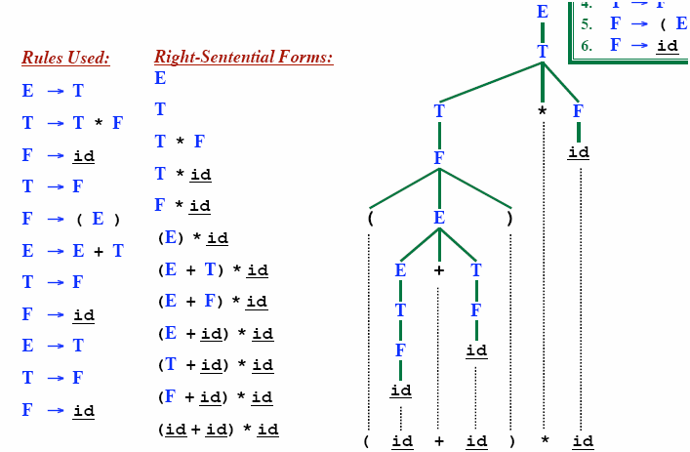
Rightmost Derivation

Slide 9
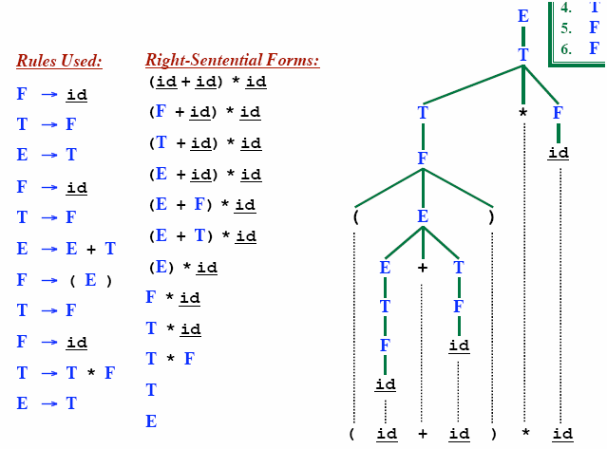
Rightmost Derivation In reverse
LR parsing corresponds to rightmost derivation in reverse

Slide 10
Shift Reduce Parsing
_{Remaining input: abbcde}
S → a T R e
T → T b c | b
R → d
Rightmost derivation:
S ➔ a T R e
➔ a T d e
➔ a T b c d e
➔ a b b c d e

Slide 11
Shift Reduce Parsing
_{Remaining input: bcde}
S → a T R e
T → T b c | b
R → d
➔
_{Shift a, Shift b}
_{a b}
Rightmost derivation:
S ➔ a T R e
➔ a T d e
➔ a T b c d e
➔ a b b c d e

Slide 12
Shift Reduce Parsing
_{Remaining input: bcde}
S → a T R e
T → T b c | b
R → d
➔
_{Shift a, Shift b}
_{Reduce T → b}
➔
_{T}
_{a b}
Rightmost derivation:
S ➔ a T R e
➔ a T d e
➔ a T b c d e
➔ a b b c d e

Slide 13
Shift Reduce Parsing
_{Remaining input: de}
S → a T R e
T → T b c | b
R → d
➔
_{Shift a, Shift b}
_{Reduce T → b}
_{Shift b, Shift c}
➔
_{T}
➔
_{a b}
_{b c}
Rightmost derivation:
S ➔ a T R e
➔ a T d e
➔ a T b c d e
➔ a b b c d e

Slide 14
Shift Reduce Parsing
_{Remaining input: de}
S → a T R e
T → T b c | b
R → d
_{T}
➔
_{Shift a, Shift b}
_{Reduce T → b}
_{Shift b, Shift c}
_{Reduce T → T b c}
➔
_{T}
➔
➔
_{a b}
_{b c}
Rightmost derivation:
S ➔ a T R e
➔ a T d e
➔ a T b c d e
➔ a b b c d e

Slide 15
Shift Reduce Parsing
_{Remaining input: e}
S → a T R e
T → T b c | b
R → d
_{T}
➔
_{Shift a, Shift b}
_{Reduce T → b}
_{Shift b, Shift c}
_{Reduce T → T b c}
_{Shift d}
➔
_{T}
➔
➔
➔
_{a b}
_{b c}
_{d}
Rightmost derivation:
S ➔ a T R e
➔ a T d e
➔ a T b c d e
➔ a b b c d e

Slide 16
Shift Reduce Parsing
_{Remaining input: e}
S → a T R e
T → T b c | b
R → d
_{T}
➔
_{Shift a, Shift b}
_{Reduce T → b}
_{Shift b, Shift c}
_{Reduce T → T b c}
_{Shift d}
_{Reduce R → d}
➔
_{T}
_{R}
➔
➔
➔
_{a b}
_{b c}
_{d}
➔
Rightmost derivation:
S ➔ a T R e
➔ a T d e
➔ a T b c d e
➔ a b b c d e

Slide 17
Shift Reduce Parsing
_{Remaining input:}
S → a T R e
T → T b c | b
R → d
_{T}
➔
_{Shift a, Shift b}
_{Reduce T → b}
_{Shift b, Shift c}
_{Reduce T → T b c}
_{Shift d}
_{Reduce R → d}
_{Shift e}
➔
_{T}
_{R}
➔
➔
➔
_{a b}
_{b c}
_{d}
_{e}
➔
Rightmost derivation:
S ➔ a T R e
➔ a T d e
➔ a T b c d e
➔ a b b c d e
➔

Slide 18
Shift Reduce Parsing
_{Remaining input:}
S → a T R e
T → T b c | b
R → d
_{S}
_{T}
➔
_{Shift a, Shift b}
_{Reduce T → b}
_{Shift b, Shift c}
_{Reduce T → T b c}
_{Shift d}
_{Reduce R → d}
_{Shift e}
_{Reduce S → a T R e}
➔
_{T}
_{R}
➔
➔
➔
_{a b}
_{b c}
_{d}
_{e}
➔
Rightmost derivation:
S ➔ a T R e
➔ a T d e
➔ a T b c d e
➔ a b b c d e
➔
➔

Slide 19
LR Parser
The LR parser is a non-recursive, shift-reduce, bottom-up parser
It uses a wide class of context-free grammar which makes it the most efficient syntax analysis technique
LR parsers are also known as LR(k) parsers
where L stands for left-to-right scanning of the input stream;
R stands for the construction of right-most derivation in reverse, and
k denotes the number of look ahead symbols to make decisions

Slide 20
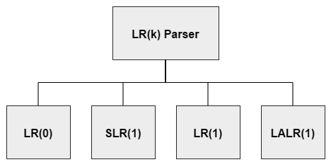
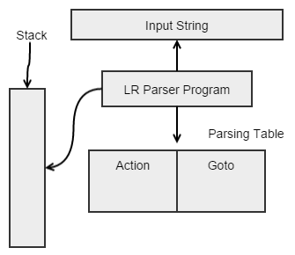
LR Parser

Slide 21
LR Parsers
LR parsing is attractive because:
LR parsing is most general non-backtracking shift-reduce parsing,
yet it is still efficient
An LR-parser can detect a syntactic error as soon as it is possible to do so a left-to-right scan of the input
LR parsers can be constructed to recognize virtually all programming language constructs for which CFG grammars can be written
Drawback of LR method:
Too much work to construct LR parser by hand
Fortunately tools (LR parsers generators) are available

Slide 22
Kinds of Parsers
Top-Down (Predictive Parsing) LL
Bottom-Up LR
LR (shift reduce) is more powerful than LL (predictive parsing)
Can detect a syntactic error as soon as possible
LR is difficult to do by hand (unlike LL)

Slide 23
LL vs. LR
LL | LR
Does a leftmost derivation. | Does a rightmost derivation in reverse.
Starts with the root nonterminal on the stack. | Ends with the root nonterminal on the stack.
Ends when the stack is empty. | Starts with an empty stack.
Uses the stack for designating what is still to be expected. | Uses the stack for designating what is already seen.
Builds the parse tree top-down. | Builds the parse tree bottom-up.
Continuously pops a nonterminal off the stack, and pushes the corresponding right hand side. | Tries to recognize a right hand side on the stack, pops it, and pushes the corresponding nonterminal.
Expands the non-terminals. | Reduces the non-terminals.
Reads the terminals when it pops one off the stack. | Reads the terminals while it pushes them on the stack.
Pre-order traversal of the parse tree. | Post-order traversal of the parse tree.

Slide 24
Example Shift-Reduce Parsing
Consider the grammar:
Stack
Input
Action
$ | id₁ + id₂$ | shift
$id₁ | + id₂$ | reduce 6
$F | + id₂$ | reduce 4
$T | + id₂$ | reduce 2
$E | + id₂$ | shift
$E + | id₂$ | shift
$E + id₂ |  | reduce 6
$E + F |  | reduce 4
$E + T |  | reduce 1
$E |  | accept

Slide 25
Conflicts During Shift-Reduce Parsing
There are context-free grammars for which shift-reduce parsers cannot be used.
Stack contents and the next input symbol may not decide action:
shift/reduce conflict: Whether make a shift operation or a reduction
reduce/reduce conflict: The parser cannot decide which of several reductions to make
If a shift-reduce parser cannot be used for a grammar, that grammar is called as non-LR(k) grammar.
left to right scanning
right-most derivation
k lookhead
An ambiguous grammar can never be a LR grammar.

Slide 26
Constructing SLR Parsing Tables – LR(0) Item
An item indicates how much of a production we have seen at a given point in the parsing process
For Example the item A → X • YZ
We have already seen on the input a string derivable from X
We hope to see a string derivable from YZ
For Example the item A → • XYZ
We hope to see a string derivable from XYZ
For Example the item A → XYZ •
We have already seen on the input a string derivable from XYZ
It is possibly time to reduce XYZ to A
Special Case:
Rule: A → ε yields only one item A → •

Slide 27
Constructing SLR Parsing Tables
A collection of sets of LR(0) items (the canonical LR(0) collection) is the basis for constructing SLR parsers.
Canonical LR(0) collection provides the basis of constructing a DFA called LR(0) automaton
This DFA is used to make parsing decisions
Each state of LR(0) automaton represents a set of items in the canonical LR(0) collection
To construct the canonical LR(0) collection for a grammar
Augmented Grammar
CLOSURE function
GOTO function

Slide 28
Constructing SLR Parsing Tables – LR(0) Item
An LR(0) item of a grammar G is a production of G with a dot at some position of the right side.
Ex: | A → aBb | Possible LR(0) Items: | A → • aBb
 |  | (four different possibility) | A → a • Bb
 |  |  | A → aB • b
 |  |  | A → aBb •
Sets of LR(0) items will be the states of action and goto table of the SLR parser.
– States represent sets of “items”
LR parser makes shift-reduce decision by maintaining states to keep track of where we are in a parsing process

Slide 29
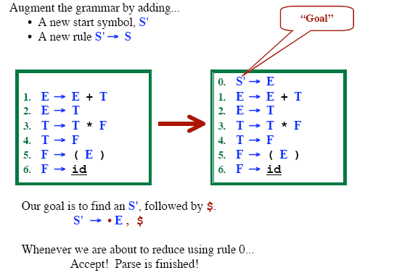
Grammar Augmentation

Slide 30
The Closure Operation
If I is a set of LR(0) items for a grammar G, then closure(I) is the set of LR(0) items constructed from I by the two rules:
Initially, every LR(0) item in I is added to closure(I).
If A → α.Bβ is in closure(I) and B→γ is a production rule of G;
then B→.γ will be in the closure(I).
We will apply this rule until no more new LR(0) items can be added to closure(I).

Slide 31
The Closure Operation -- Example
closure({E' → .E}) =
E' → E
E → E+T | { | E' → •E kernel items
E → T |  | E → •E+T
T → T*F |  | E → •T
T → F |  | T → •T*F
F → (E) |  | T → •F
F → id |  | F → •(E)
 |  | F → •id }

Slide 32
GOTO Operation
If I is a set of LR(0) items and X is a grammar symbol (terminal or non-terminal), then GOTO(I,X) is defined as follows:
– If A → α • Xβ in I
then every item in closure({A → αX • β}) will be in GOTO(I,X).
Example:
I ={ E’ → • E, E → • E+T,
T → • T*F, T → • F, F → • (E), F → • id }
E → • T,
GOTO(I,E) = { E’ → E • , E → E • +T } GOTO(I,T) = { E → T • , T → T • *F } GOTO(I,F) = {T → F • }
GOTO(I,() = { F → (• E), E → • E+T, E →
F → • (E), F → • id } GOTO(I,id) = { F → id • }
• T, T → • T*F, T → • F,

Slide 33
Construction of The Canonical LR(0) Collection (CC)
To create the SLR parsing tables for a grammar G, we will create the canonical LR(0) collection of the grammar G’.
Algorithm:
C is { closure({S'→ • S}) }
repeat the followings until no more set of LR(0) items can be added to C.
for each I in C and each grammar symbol X
if GOTO(I,X) is not empty and not in C
add GOTO(I,X) to C
GOTO function is a DFA on the sets in C.

Slide 34
The Canonical LR(0) Collection -- Example
I₀: E’ → .E E → .E+T | I₁: E’ → E. E → E.+T | I₆: E → E+.T T → .T*F | I₉: E → E+T. T → T.*F
E → .T |  | T → .F
T → .T*F T → .F | I₂: E → T. T → T.*F | F → .(E) F → .id | I₁₀: T → T*F.
F → .(E)
F → .id | I₃: T → F. | I₇: T → T*.F F → .(E) | I₁₁: F → (E).
 | I₄: F → (.E) E → .E+T | F → .id
 | E → .T T → .T*F | I₈: F → (E.) E → E.+T
 | T → .F
 | F → .(E)
 | F → .id
I₅: F → id.

Slide 35
Transition Diagram (DFA) of Goto Function
I₀
E
I₁
+
I₆
T
I₉
to I₃
*
to I₇
F
(
T
_{id} to I₄
to I₅
F
I₂
*
I₇
F (
id
^{I}10
to I₄
to I₅
I₃
(
I₄
id
I₅
E
I₈
to I₂ to I₃ to I₄
)
+
id
T
F
(
^{I}11
to I₆

Slide 36
Constructing SLR Parsing Table
(of an augumented grammar G’)
Construct the canonical collection of sets of LR(0) items for G’. C←{I₀,...,I_{n}}
Create the parsing action table as follows:
If a is a terminal, A→α.aβ in I_{i} and goto(I_{i},a)=I_{j} then action[i,a] is shift j.
If A→α. is in I_{i} , then action[i,a] is reduce A→α for all a in FOLLOW(A) where A≠S’.
If S’→S. is in I_{i} , then action[i,$] is accept.
If any conflicting actions generated by these rules, the grammar is not SLR(1).
Create the parsing goto table
for all non-terminals A,
if goto(I_{i},A)=I_{j} then goto[i,A]=j
All entries not defined by (2) and (3) are errors.
Initial state of the parser contains S’→.S

Slide 37
Parsing Tables of Expression Grammar
Action Table
Goto Table
state | id | + | * | ( | ) | $ |  | E | T | F
0 | s5 |  |  | s4 |  |  |  | 1 | 2 | 3
1 |  | s6 |  |  |  | acc
2 |  | r2 | s7 |  | r2 | r2
3 |  | r4 | r4 |  | r4 | r4
4 | s5 |  |  | s4 |  |  |  | 8 | 2 | 3
5 |  | r6 | r6 |  | r6 | r6
6 | s5 |  |  | s4 |  |  |  |  | 9 | 3
7 | s5 |  |  | s4 |  |  |  |  |  | 10
8 |  | s6 |  |  | s11
9 |  | r1 | s7 |  | r1 | r1
10 |  | r3 | r3 |  | r3 | r3
11 |  | r5 | r5 |  | r5 | r5

Slide 38
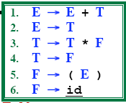
(SLR) Parsing Tables for Expression Grammar
Action Table
Goto Table
state | id | + | * | ( | ) | $ |  | E | T | F
0 | s5 |  |  | s4 |  |  |  | 1 | 2 | 3
1 |  | s6 |  |  |  | acc
2 |  | r2 | s7 |  | r2 | r2
3 |  | r4 | r4 |  | r4 | r4
4 | s5 |  |  | s4 |  |  |  | 8 | 2 | 3
5 |  | r6 | r6 |  | r6 | r6
6 | s5 |  |  | s4 |  |  |  |  | 9 | 3
7 | s5 |  |  | s4 |  |  |  |  |  | 10
8 |  | s6 |  |  | s11
9 |  | r1 | s7 |  | r1 | r1
10 |  | r3 | r3 |  | r3 | r3
11 |  | r5 | r5 |  | r5 | r5
Key to Notation
S4=“Shift input symbol and push state 4”
R5= “Reduce by rule 5” Acc=Accept (blank)=Syntax Error

Slide 39
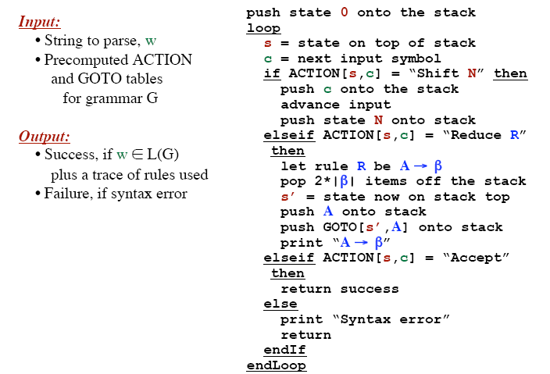
LR Parsing Algorithm

Slide 40
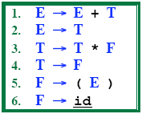

Example LR Parse: (id+id)*id

Slide 41

Example LR Parse: (id+id)*id

Slide 42
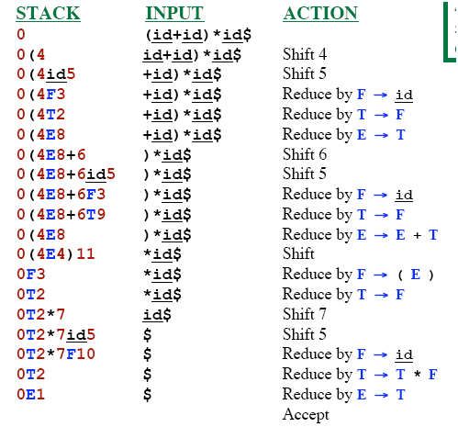
Example LR Parse: (id+id)*id

Slide 43
SLR Grammar: Review
An LR parser using SLR parsing tables for a grammar G is called as the SLR parser for G.
If a grammar G has an SLR parsing table, it is called SLR grammar (or SLR grammar in short).
Every SLR grammar is unambiguous, but every unambiguous grammar is not a SLR grammar.
If the SLR parsing table of a grammar G has a conflict, we say that that grammar is not SLR grammar.

Slide 44
Any Questions ?

